Slide 1


FINAL YEAR PROJECT
Beaker Breakers Studio
Redefining Virtual Scientific Exploration
Beaker Breakers Studio • Virtual Lab Platform • FYP 2026

Slide 2


FINAL YEAR PROJECT
🧪
Syed Mohsin Abbas | Rabail Mehboob
BSSE 012313006 | BSCS 012313003
SE 7th | CS 7th
Redefining Virtual Scientific Exploration
Supervisor : Ms. Mehk Fatima
Co-supervisor : Dr. Waqas Ahmed
Department of Computer Science • FYP Presentation 2026
Beaker Breakers Studio • Virtual Lab Platform • FYP 2026

Slide 3



ABOUT THE PROJECT
Reimagining Science Education
🏛️
Digital Studio Platform
A fully interactive, browser-based scientific studio designed for safe and engaging virtual experimentation.
🎯
Our Mission
Empower students to 'break' experiments virtually — learning through failure without real-world risk, cost, or consequence.
🌐
Accessibility First
Available to any student with internet access — breaking the barrier of expensive lab equipment and limited seats.
PROJECT VISION
INTRODUCTION

Slide 4

PROBLEM STATEMENT
Safety, Cost & Accessibility Challenges
⚗️
Chemical Hazards
💰
High Material Costs
Traditional labs expose students to dangerous chemicals, fire, and injury risk — especially in high school and undergraduate settings.
Physical reagents, glassware, and equipment are expensive. Budget constraints limit the number of trials students can perform.
🔁
Limited Repetition
🏫
Access Inequality
Once an experiment fails, materials are gone. Students rarely get a second chance — slowing down comprehension and mastery.
Schools in under-resourced regions often lack proper labs entirely, creating an educational gap that leaves students behind.

Slide 5
LITERATURE REVIEW
Previous Systems & Key Gaps
Existing platforms reviewed and their key limitations:
Labster (2012)
PhET (2002)
🎯 Target: University
🎯 Target: K-12 + Uni
✗ No gamification, no AR, no dedicated school portal. Expensive institutional subscription.
✗ No AI guidance, no safety certification, no performance tracking or teacher dashboard.
PraxiLabs (2017)
OLabs (2012)
🎯 Target: College
🎯 Target: Class 9–12
✗ No game mode, no AR, no readiness prediction. Biology & physics focus — not chemistry-only.
✗ No AI, no gamification, no digital safety certificate. Limited to 46 chemistry experiments.

Slide 6
CONTRIBUTION & NOVELTY
Project Contribution & Novelty
What makes Beaker Breakers Studio unique — features NO existing platform offers together:
🦋
AR Storytelling Mode
🐉
Real-Time AI Guidance
🦁
4-Tier Safety Certification
3D chemistry in student's real room via smartphone camera — no special hardware needed.
Real time AI guidance on each step, detects errors instantly & explains concepts naturally.
Interactive training + digital certificate issued before any experiment is unlocked.
🐸
6-Dimension AI Scoring
🦊
AI Readiness Predictor
🦄
Full Gamification Engine
Procedural Accuracy, Safety, Reagent Use, Time, Conceptual Understanding & Error Recovery.
Teachers get AI reports: Not Ready / Approaching Readiness / Ready for real lab.
XP, 60+ badges, 8 rank levels, class leaderboards, weekly missions & streak tracking.

Slide 7
FEATURE COMPARISON
Beaker Breakers vs Existing Platforms
Beaker Breakers Studio vs Existing Platforms
Feature
Labster
PhET
PraxiLabs
OLabs
🧪 Beaker Breakers
Target Level
University
K-12+Uni
College
Class 9–12
Secondary ✓
Game Mode (Levels)
✗
✗
✗
✗
✓
AR Mode (Smartphone)
✗
✗
✗
✗
✓
Real-Time AI Guidance
✗
✗
✗
✗
✓
4-Tier Safety Certificate
✗
✗
✗
✗
✓
AI Readiness Predictor
✗
✗
✗
✗
✓
XP / Badges / Leaderboard
~
✗
~
✗
✓
Dedicated School Portal
✗
✗
~
~
✓
✓ = Offered ✗ = Not available ~ = Partial

Slide 8



🧪
THE SOLUTION
Beaker Breakers Ecosystem
🏠
🔬
🛡️
🏆
Home
Labs
Safety
Leaderboard
Dashboard
Experiments
Certification
Competition
Centralised overview of your progress, recent experiments, notifications, and personalised study recommendations.
Interactive 3D Chemistry experiments with step-by-step guided trials.
Gamified safety training with quizzes, simulations, and awarded digital certifications upon successful completion.
Real-time ranking system that fosters healthy competition and motivates students through visible academic progress.

Slide 9
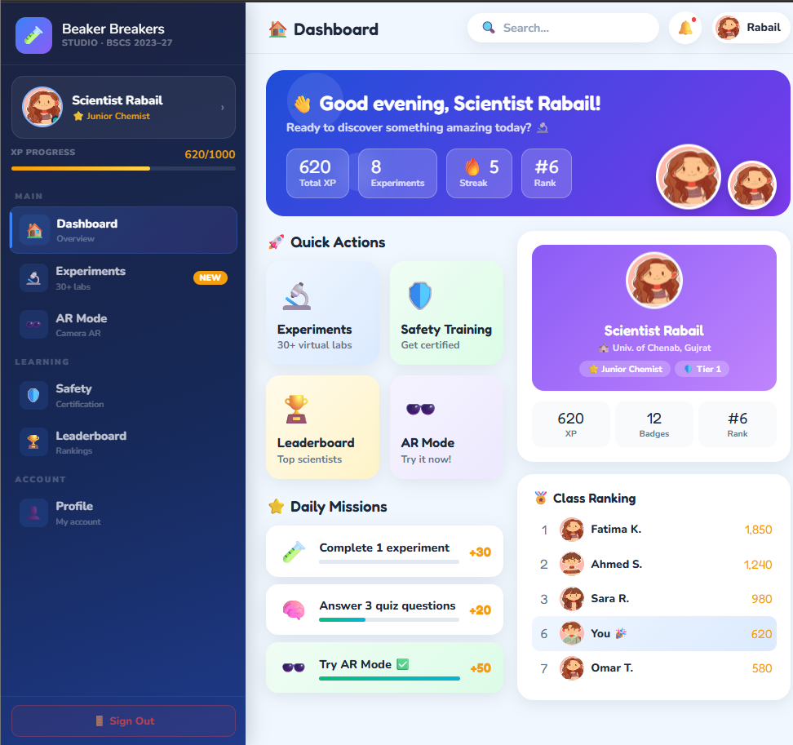
DESIGN PHILOSOPHY
UI/UX Design Principles
✨
Minimalist & Clean
Clutter-free layout with purposeful whitespace. Every element earns its place — no decorative noise.
💎
Premium Aesthetic
Soft, modern, and Instagram-ready look. Uses a carefully curated color palette that feels fresh and approachable.
🎮
Intuitive Navigation
Taskbar-driven transitions between modules. Users can switch contexts in one tap with zero learning curve.
♿
Inclusive by Design
High contrast ratios, legible font sizes, and keyboard-accessible interactions for diverse user needs.

Slide 10

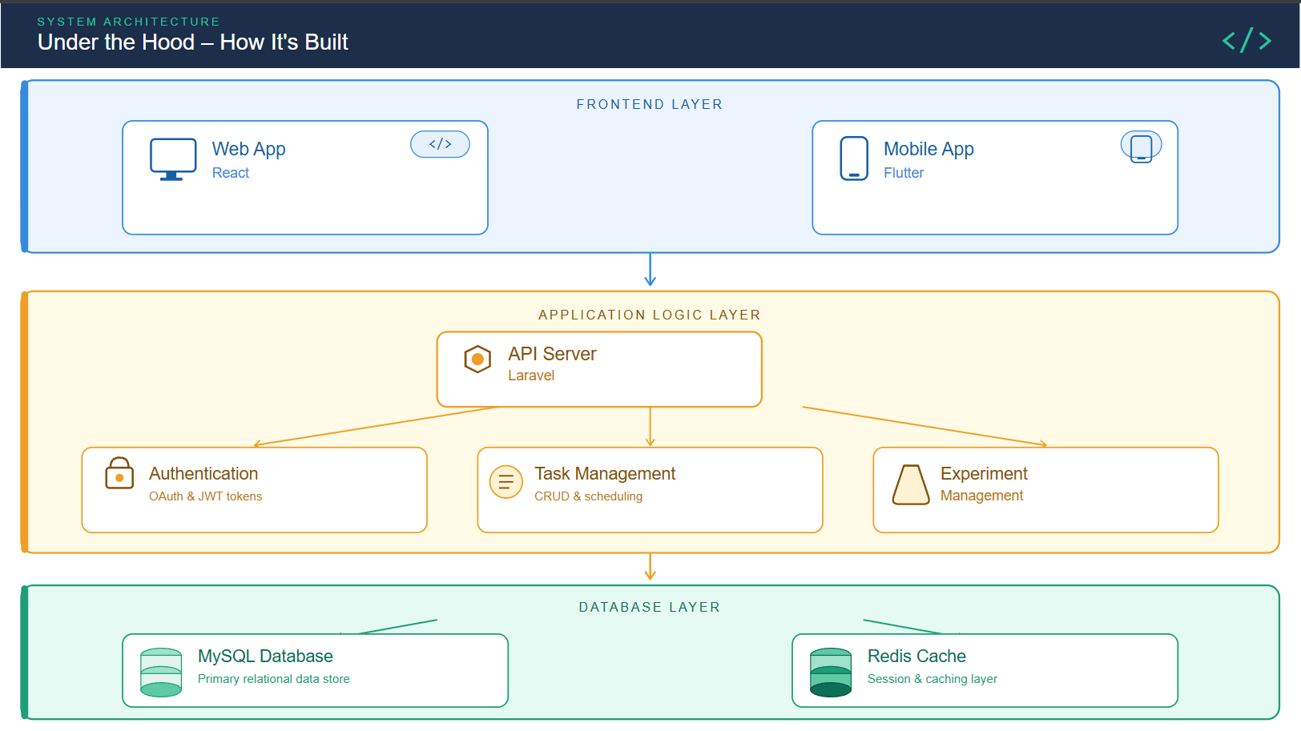
TECHNICAL ARCHITECTURE
Under the Hood

Slide 11
REQUIREMENTS
Functional & Non-Functional Requirements
⚙️ Functional Requirements
🔒 Non-Functional Requirements
Multi-role login: Student, Teacher, Admin
Performance
AI response < 2s; 99.5% uptime
Safety certification quiz per tier (4 tiers)
Security
JWT auth, HTTPS, encrypted data
Virtual experiment execution with AI step guidance
Scalability
Cloud deployment (AWS EC2)
AR experiment mode via device camera
Usability
HCI-compliant, child-friendly UI
Real-time AI scoring across 6 performance dimensions
Compatibility
Chrome 90+, Android 7+, iOS 11+
XP system, badges, leaderboards & missions
Reliability
Redis caching, queue-based jobs
AI-generated readiness report for teachers
Accessibility
WCAG-aligned, works on 3G
Push notifications via Firebase Cloud Messaging
Maintainability
Modular Laravel + React codebase

Slide 12
TECH STACK
Technologies & Tools Used
Every technology chosen for a specific reason — optimised for Pakistani school deployments:
L
F
R
G
Laravel (PHP)
Flutter + Dart
React.js + Next.js
Gemini API
Backend REST API
Mobile App
Web Frontend
AI Guidance & Reports
Native shared hosting in Pakistan — minimal server cost
Single codebase → Android + iOS; mature ARCore/ARKit plugin
SSR for fast load; huge ecosystem for rapid UI development
State-of-the-art LLM; no model training or hosting required
M
A
E
A
MySQL + Redis
ARCore + ARKit
ElevenLabs API
AWS S3 + Cloudflare
Database & Cache
Augmented Reality
Avatar Voice
Storage & CDN
ACID relational storage + sub-ms leaderboard caching
Proven production AR on mid-range phones; no specialist hardware
Most natural AI voice synthesis for avatar experience quality
Global fast asset delivery for students in all geographic zones

Slide 13


?
Thank You!
Beaker Breakers Studio – Redefining Virtual Scientific Exploration
✅ Safe, cost-free virtual experimentation
🎮 Gamified learning with real certificates
🌐 Accessible to any student, anywhere
🚀 Ready for AR & mobile expansion
Prepared by: Syed Mohsin Abbas & Rabail Butt | Final Year Project – Computer Science | 2026

